Slide 1
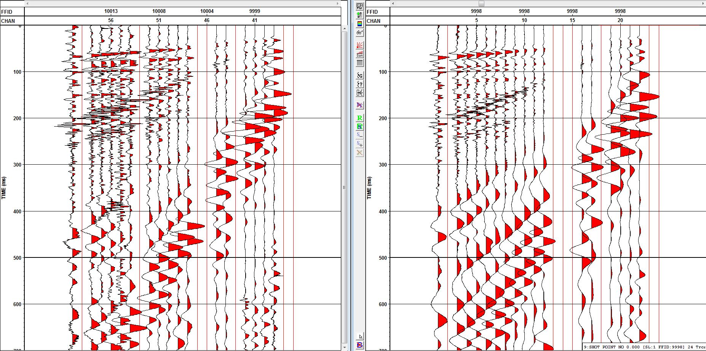
Traditional System
V_{geophone} (V)
SeismicDart Autonomous Deployment System
V_{geophone} (V)
0 100 200 300 400 500 600 700
Time (ms)

